Slide 1
Advanced Fine Tuning: Drug Classification
Savitha Shree M (19981)

Slide 2
TABLE OF CONTENTS
INTRODUCTION
DESIGN
IMPLEMENTATION
SAMPLE OUTPUT
CONCLUSION

Slide 3
INTRODUCTION
The project is to implement a fine-tuned model based on 2000 drug samples from an excel file. Fine-Tuning is a training technique used to adapt pre-trained language models to specific tasks or domains.
It is applied to various natural language processing tasks to adapt models to specific domains or tasks, including
sentiment analysis
text classification
named entity recognition
machine translation

Slide 4
DESIGN
It is built in Python Programming language.
davinci-002 model is used for this project.
The three major steps involved are:
Preparing the data
Creating a fine-tuned model
Testing the model

Slide 5
INSTALLATION
Create python virtual environment
sudo apt install python3.10 -venv
Install the required packages
python -m venv env
source env/bin/activate
pip install -r requirements.txt

Slide 6
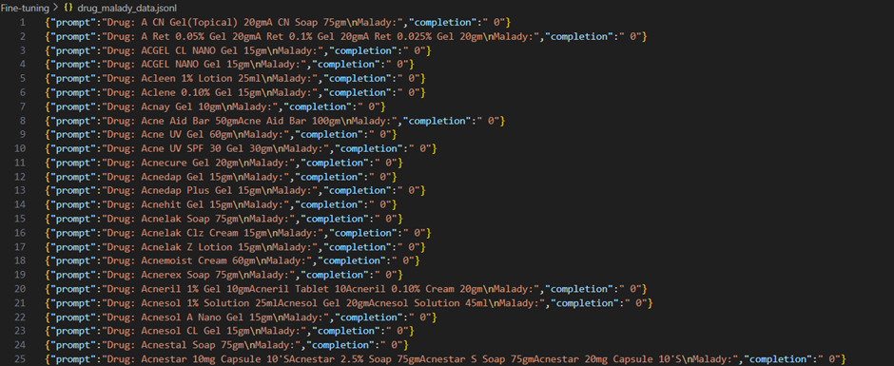
IMPLEMENTATION
PREPARING THE DATA - The data is in the form of Excel sheet and we have to convert to jsonl in the prompt completion format. The jsonl file looks like:

Slide 7
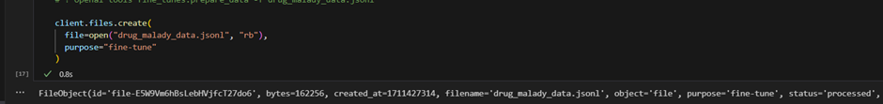
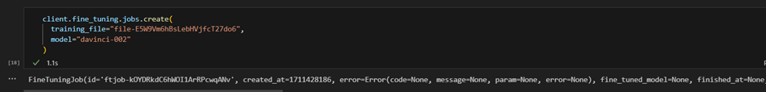
IMPLEMENTATION
CREATING A FINE-TUNED MODEL:
Upload the jsonl file using Files API for training.
Create a fine-tuned model using the generated file-id.

Slide 8
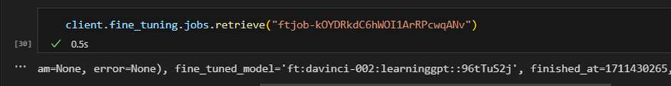
IMPLEMENTATION
CREATING A FINE-TUNED MODEL:
This process can take some time to complete.
It is possible to check the status of a job by mentioning the job ID:
The user will also get an email when the job is completed

Slide 9
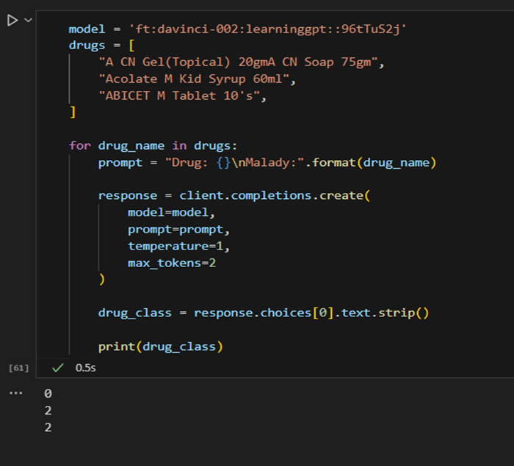
IMPLEMENTATION
TESTING THE FINE-TUNED MODEL:

Slide 10
CONCLUSION
GITHUB LINK:
https://github.com/savithashreem07/Fine-Tuning/tree/feature/fine-tune-drug
REFERENCES:
https://platform.openai.com/docs/guides/fine-tuning

